Slide 1
Chapter Fourteen
Operating System Administration

Slide 2


220-902 Objectives Covered
1.1 Compare and contrast various features and requirements of Microsoft Operating Systems (Windows Vista, Windows 7, Windows 8, Windows 8.1).
1.2 Given a scenario, install Windows PC operating systems using appropriate methods.
1.3 Given a scenario, apply appropriate Microsoft command line tools.
1.4 Given a scenario, use appropriate Microsoft operating system features and tools.
1.5 Given a scenario, use Windows Control Panel utilities.
1.7 Perform common preventive maintenance procedures using the appropriate Windows OS tools.

Slide 3
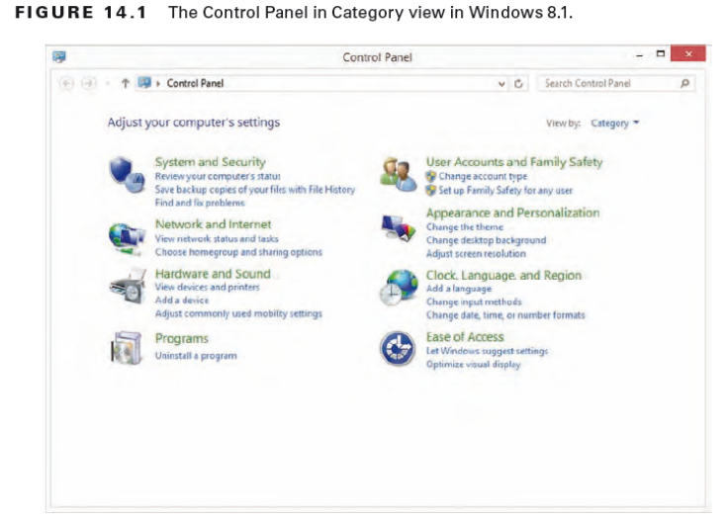
Control Panel
Switch To Classic View.
Most applets have .cpl extension.
Know the applets CompTIA stresses for the exam.
EX 14.1
Changing the Time Zone
Notes:
Most common configuration utility in Windows

Slide 4
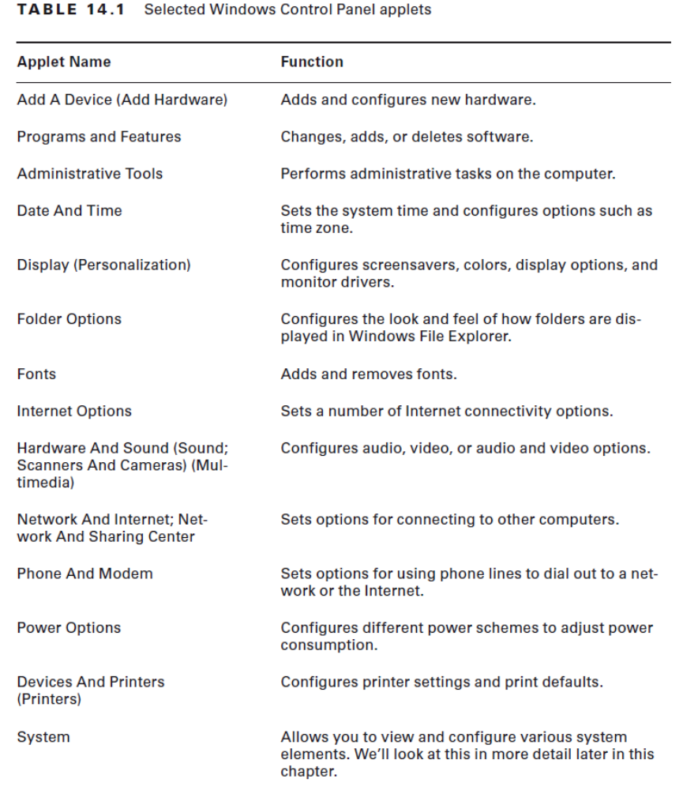

Slide 5
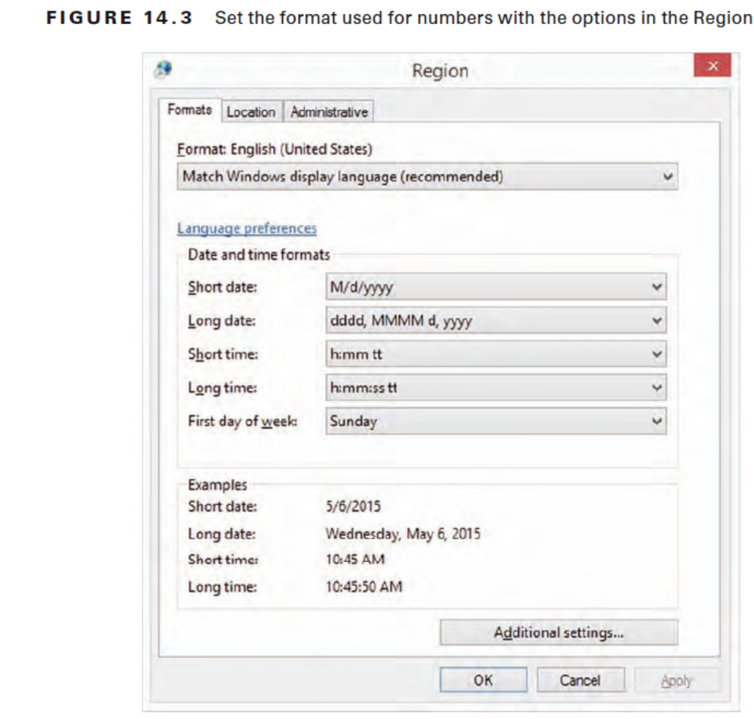
Notes:
Regional settings are configured through the Control Panel applet called Region in
Windows 8/8.1, Region And Language in Windows 7, and Regional And Language Options in Windows Vista.
The ability to support so many languages is provided through the use of the Unicode
standard. In Unicode, and the Unicode Character Set (UCS), each character has a 16-bit
value.
.

Slide 6
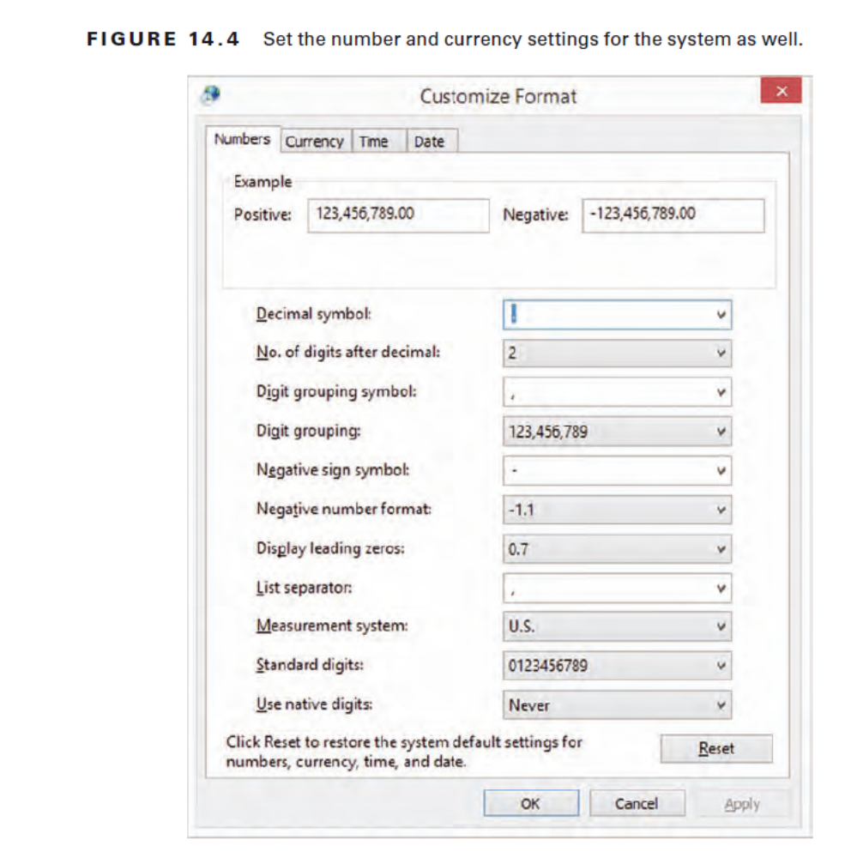
EX 14.2 Showing Hidden Files and Folders
Notes:
If you click Additional Settings, you can go beyond the date and time formats and also
configure number and currency

Slide 7
System Applet
Network Identification
Device Manager
Hardware
User Profiles
Environment Variables
Startup And Recovery
Performance
System Restore
Remote
Computer Name
Advanced
Notes:
Driver Signing – Microsoft allows you to install only drivers that have been checked (signed) to minimize the risk of malicious software/viruses

Slide 8
OS Command-Line Tools
TASKKILL
BOOTREC
SHUTDOWN
TASKLIST
MD/RD/CD
DEL
FORMAT
COPY/XCOPY/ROBOCOPY
DISKPART
SFC
CHKDSK
GPUPDATE
GPRESULT
DIR
EXIT
HELP
EXTRACT
/?
Notes:
TASKKILL.EXE utility is used to terminate processes
BOOTREC – run tool from installation disk. /Fixboot (write new boot sector), /FixMBR (writes new Master Boot Record), /REbuildBCD (rebuild Boot configuration data), /ScanOS scans all disksfor installations
SHUTDOWN.EXE utility can be used to schedule a shutdown
TASKLIST.EXE utility is used at the command line to see a list of all the running processes
CD, MD, and RD commands are used to change (or display), make, and remove directories, respectively. They’re shorthand versions of the CHDIR, MKDIR, and RMDIR commands
DEL command is used to delete files – ERASE performs the same function
FORMAT command is used to wipe data off disks and prepare them for new use –e.g. FORMAT D: /FS:NTFS /V:HDD2
COPY command does what it says: It makes a copy of a file in a second location (copies files ONLY)
XCOPY - it’s designed to copy directories as well as files
ROBOCOPY utility (Robust File Copy for Windows) is included with recent versions of Windows and has the big advantage of being able to accept a plethora of specifications and keep NTFS permissions intact in its operations
DISKPART - utility shows the partitions and lets you manage them on the computer’s hard drives
Commands:
Taskkill /PID 11848 OR Taskkill /IM snippingtool.exe
PID = Process ID and IM = Image name
There are two signals that can be sent: the default is SIGTERM
(a gentle kill, related to code 15) and the /F switch issues a SIGKILL (a terminate at all cost
kill, related to code 9). i.e Taskkill /F /PID 11848
EX14.3 Command-Line Directory Management

Slide 9
OS Command-Line Tools
TASKKILL (terminate processes)
BOOTREC
SHUTDOWN
TASKLIST
MD/RD/CD
DEL
FORMAT
COPY/XCOPY/ROBOCOPY
DISKPART
SFC
CHKDSK
GPUPDATE
GPRESULT
DIR
EXIT
HELP
EXTRACT
/?
Notes:
System File Checker (SFC) is a command-line-based utility that checks and verifies the versions of system files on your computer
Chkdsk utility to create and display status reports for the hard disk. Chkdsk can also correct filesystem problems (such as cross-linked files) and scan for and attempt to repair disk errors.
GPEDIT - is used to update Group Policy settings
GPRESULT command is used to show the Resultant Set of Policy (RSoP) report/values for a remote user and computer
DIR command is used to display a list of the files and folders/subdirectories within a directory
EXIT command is used to get you out of what you are currently in
EXPAND command can be used to expand one or more compressed files
HELP command does what it says: it gives you help
EXTRACT – opens files that are zipped
/? – Shows help information – slightly faster
EX14.4 Running Chkdsk within Windows
EX 14.5 Run Chkdsk at command line

Slide 10
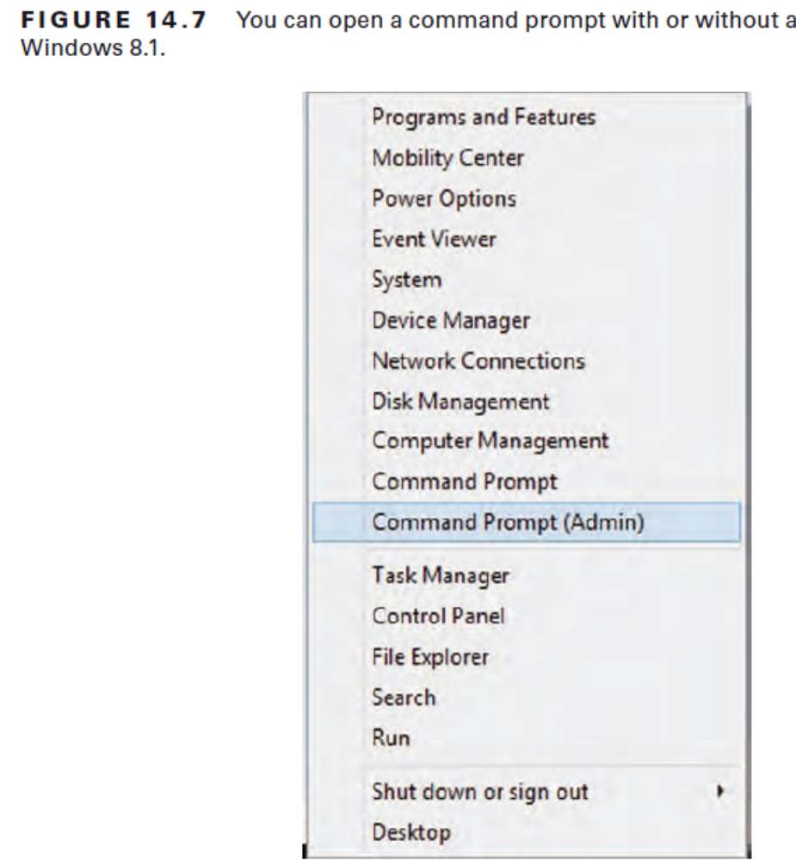
Notes:
certain commands that can be dangerous when run by a standard user (can run CMD) and, as a safety precaution, require administrative privileges

Slide 11
Windows Registry
Windows configuration information is stored in a special configuration database known as the Registry.
This centralized database contains environmental settings for various Windows programs.
The Registry is broken down into a series of separate areas called hives like HKEY_CURRENT_USER

Slide 12
Restoring the Registry
System restore will restore the Registry to the state it was in when a restore point was saved
Last Known Good Configuration option, which restores the Registry from a backup of its last functional state (F8 at POST)
You can also back up the Registry files to the systemroot\repair directory by using the Windows Backup program and overwrite the Registry files in systemroot\system32\config

Slide 13
Virtual Memory
Virtual memory uses a swap file, or paging file (pagefile.sys)
A swap file is actually hard drive space into which idle pieces of programs are placed while other active parts of programs are kept in main memory.
When application needs info it’s swapped back to memory

Slide 14
Administrative Tools
(Simplify System Administration)
Computer Management (MMC)
Device Manager
Performance Monitor
Task Manager
Services
Task Scheduler
Notes:
Microsoft Management Console (MMC) interface is where you run administrative tools

Slide 15
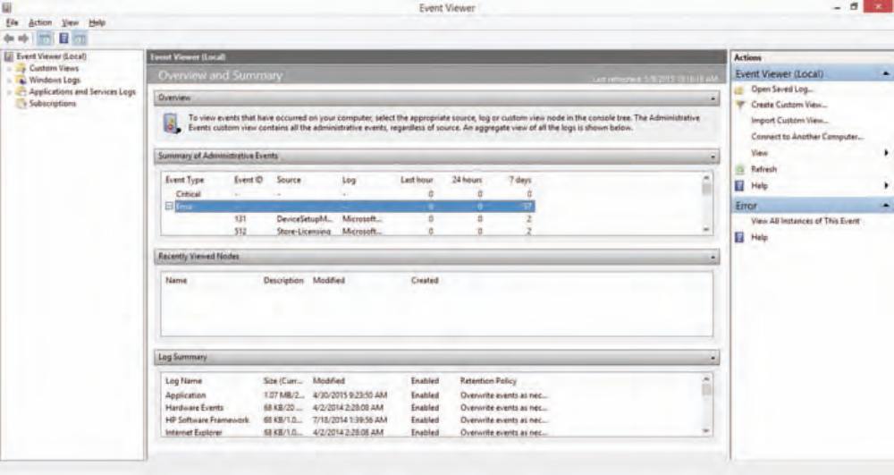
Microsoft Management Console (manage computer settings)
Notes:
MMC - also contains Event Viewer to show any system errors and events as well as methods to configure the software components of all of the computer’s hardware
To access the Computer Management Console, you can go through Administrative Tools in Control Panel or just right-click the Computer/My Computer icon and choosing Manage
The following System Tools are available in MMC:
Device Manager Lets you manage hardware devices.
Event Viewer - allows you to view application error logs, security
audit records, and system errors.
Shared Folders Allows you to manage all of your computer’s shared folders.
Local Users And Groups Allows you to create and manage local user and group accounts
SERVICES.MSC is an MMC snap-in that allows you to interact with the services running on the computer. Select Start Control Panel Administrative Tools, and choose Services.

Slide 16
Task Manager
Task Manager lets you shut down nonresponsive applications selectively in all Windows versions.
To display Task Manager, press Ctrl+Alt+Delete and click the Task Manager button or option

Slide 17
Task Manager
Applications
Processes
Performance
Networking
Users
Notes:
The Applications tab lets you see which tasks are open on the machine
Process/Details tab - Windows 7, the Processes tab lets you see the names of all the processes running on the machine, whereas with Windows 8/8.1, this tab now shows what Applications once did (and a little more).
You can END or change priority of processes (Low, Below Normal, Above Normal, High, Realtime)
The Performance tab will display a variety of information, including overall CPU usage percentage, a graphical display of CPU usage history, page-file usage in MB, and a graphical display of physical memory
Networking In Windows Vista and Windows 7, the Networking tab provides you with a graphical display of the performance of your network connection; With Windows 8, this information is provided on the Performance tab
The Users tab provides you with information about the users connected to the local machine.
The Startup tab lists the name of services configured to begin at startup as well as the publisher, status, and startup impact

Slide 18
Performance Monitor
Collects counter information and then send that information to a console or event log.
EX 14.6 Working with Performance Monitor

Slide 19
Task Scheduler
Allows you to configure an application to run automatically or at any regular interval
Start-All Programs-Accessories
-System Tools -Task Scheduler
Notes:
Options for configuring tasks:
action (what the task actually does),
condition (an optional requirement that must be met before a task runs),
setting (any property that affects the behavior of a task), and
trigger (the required condition for the task to run).
For example, you could configure a report to run automatically (action) every Tuesday (trigger) when the system has been idle for 10 minutes (condition), and only when requested (setting).

Slide 20
MSCONFIG
Common tabs:
General
Boot
Services
Startup
Tools

Slide 21
Disk Management
Partitioning is the process of creating logical divisions on a hard drive
Formatting is the process of creating and configuring a file allocation table (FAT) and creating the root directory
E.g. NTFS available in all Windows is called a Master File Table (MFT)
Notes:
NTFS - New Technology Filesystem (NTFS)

Slide 22
File Systems
FAT
VFAT
FAT32
NTFS
CDFS
ExFAT
NFS
ext
Notes:
File Allocation System (FAT) filesystem uses the 8.3 naming convention (eight letters for the name, a period, and then a three-letter file identifier). Aka Fat 16
Virtual FAT – Introduced with Win95, augmented the 8.3 file-naming convention and allowed filenames with up to 255 characters. It created two names for each file: a long name and an 8.3-compatible name so that older programs could still access files. Also 16bit and also 2GB max partition size
FAT32 – Win95 Release 2 was based more on VFAT than on FAT16. Allows 32bit clustering with a 2TB max partition size
New Technology File System (NTFS) – Windows NT, includes individual file security, compression and RAID
CD-ROM File System (CDFS) While not a filesystem that can be used on a hard drive, CDFS is the filesystem of choice for CD media, and it has been used with 32-bit Windows versions since Windows 95.
Extended File Allocation Table (ExFAT) – proprietary filesystem of choice for flash drives where NTFS cannot be used (because of overhead) and FAT32 is not acceptable (due to filesystem limitations)
Network File System (NFS) - used in Unix and Linux environments. Also Windows 7, runs Windows services for Unix
Extended File System (ext) – Not supported in Windows – ext3 default filesystem for many distributions of Linux due to its journaling capabilities (i.e. tracking changes and using it to repair inconsistencies that result from for example improper shut down). Ext4 used with Android

Slide 23
Disk Management
Drive Status
Mounting
Initializing
Extending partitions
Splitting partitions
Shrink partitions
Assigning drive letters
Adding drives
Adding Arrays
Storage spaces

Slide 24
System Utilities
REGEDIT
COMMAND
SERVICES.MSC
MMC
MSTSC
EXPLORER
MSINFO32
DXDIAG

Slide 25
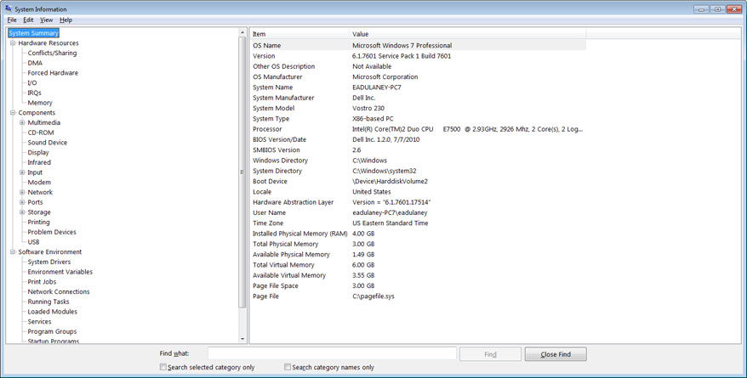
MSINFO32

Slide 26
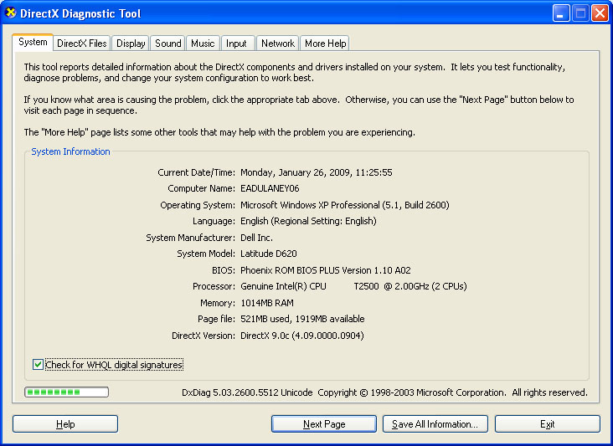
DxDIAG
Notes:
DxDiag (DirectX Diagnostic) tool allows you to test DirectX functionality. When you start it, you can also verify that Microsoft has signed your drivers, as shown in Figure above

Slide 27
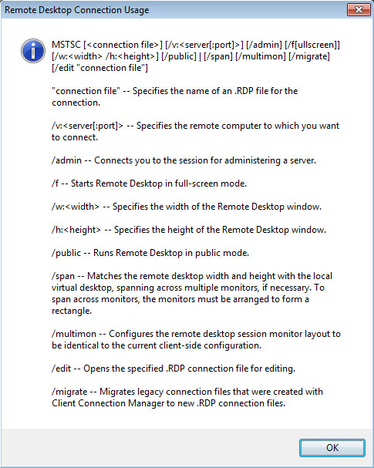
MSTSC
Notes:
MSTSC (Remote Desktop Connection) is used to configure remote desktop connections.

Slide 28
Power Management
Hibernate saves all the contents of memory to the hard drive, preserves all data and applications exactly where they are, and allows the computer to completely power off.
Standby leaves memory active but saves everything else to disk.
Suspend/Sleep: Sleep puts the system in a low-power state (while Hibernate turns it off).

Slide 29
Wake on LAN (WoL)
Wake on LAN is an Ethernet standard implemented via a card that allows a “sleeping” machine to awaken when it receives a wakeup signal.

